Slide 1
Clustering Based Recommendation Systems
Capstone Project: Team #14
Rahul 4. Sushma
Siddhant 5. Krunal
Himangshu 6. Harsha

Slide 2
Introduction

Slide 3
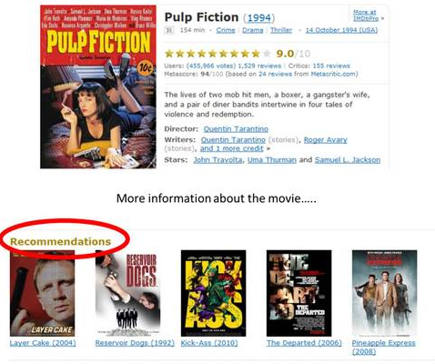
INTRODUCTION
Recommendations systems give two kinds of feedbacks:
Explicit feedback from Users
Implicit feedback from associated with user data
Associating all the users and products for generating recommendations are often not meaningful

Slide 4
Dataset

Slide 5
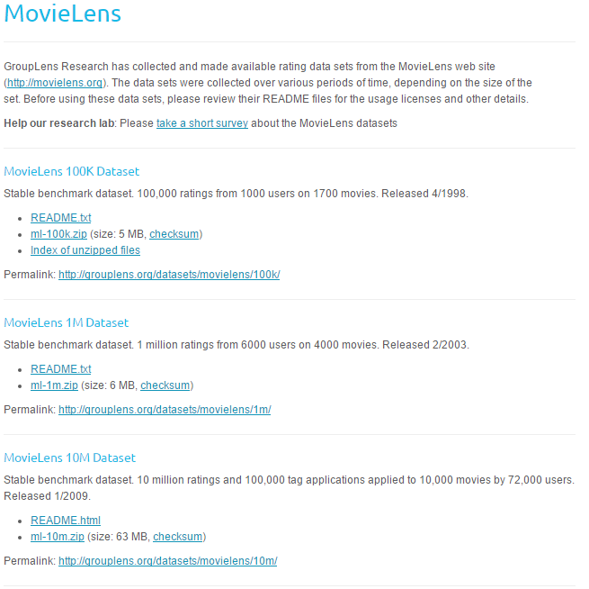
Data Set
MovieLens Dataset
100,000 Ratings (1 - 5)
Available in different granularities.
Structure:
943 Users on 1682 Movies
Each user has rated at least 20 movies
Simple demographics info of users.

Slide 6
BI Use Case

Slide 7
BI use case : Problems with Original Algorithms
The raw algorithms run on the whole database of users and items.
Two typical problems:
Exponentially huge size of User-Item matrix.
Doesn’t leverage the association, similarity and dissimilarity between users and items.

Slide 8
Approach

Slide 9

Clustering- The Concept
Significance:
Speed
Size
Meaning of Recommendation
Types:
User Clustering
Item Clustering

Slide 10
Optimist, Pessimist and Neutral Users
Normally done using Demographics, but not good.
Using user prior recommendation information.
Set α and β, as defined in the paper.
Select UL, UH and UN
Find the leaders.

Slide 11
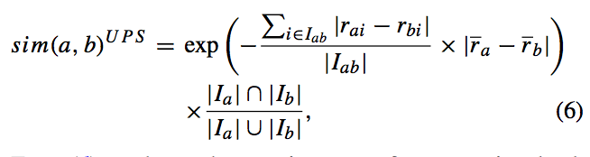
Similarity Matrices
Baseline Matrices PCC and Cosine.
New matrix UPS.

Slide 12
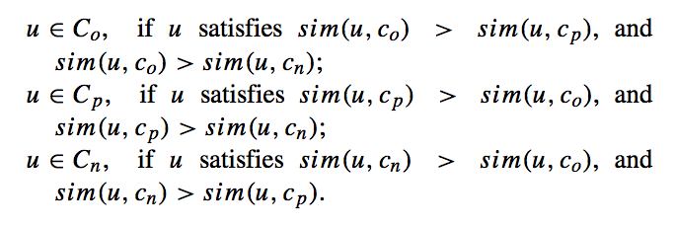
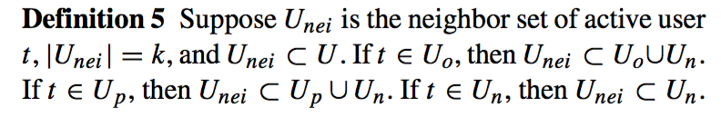
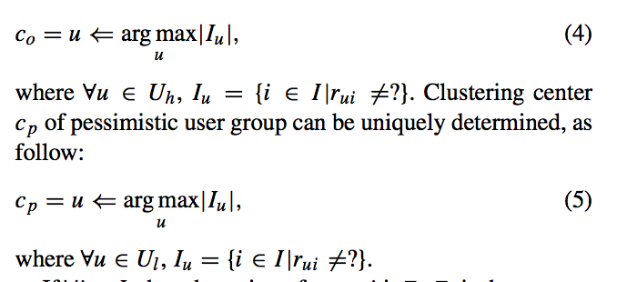
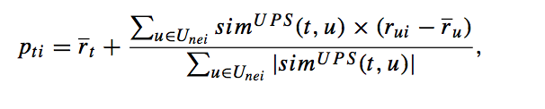
Clustering
Recommendations

Slide 13
Evaluation and Observation

Slide 14
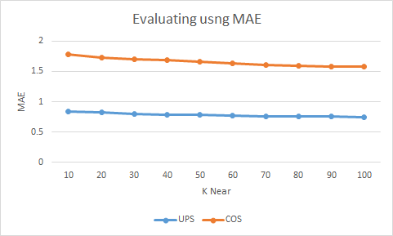
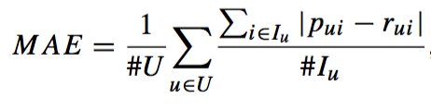
Evaluation and observations
UPS similarity metrics as compared to Cosine similarity metrics
Optimal value of K

Slide 15
Conclusion and Future Work

Slide 16
Conclusion and Future Work
Introducing the Bias into the recommendation system.
How will it behave if done for items?
Refine the criteria of optimism and pessimism.
The people who give bad ratings on very famous and enjoyed items are the pessimists!

